Slide 1


Logic Design CSE 111 Design and Implement of an ALU
AIN SHAMS UNIVERSITY FACULTY OF ENGINEERING Credit Hours Engineering Programs - CHEP Mechatronics and Automation Program
Made and presented by: Team 31
Mohammed Ashraf Saeed Mohammed Marzouk Eladwy 18P5496 Mohamed Eyad Sayed Abdallah Khalaf 18P8431 Osama Ahmed Mesbah Kamal Elhout 16p8154
Fall 2020
Submitted to: Dr. Manal Tantawi Date of submission: 19/01/2021

Slide 2
The requirements of the system
Add operation
Subtraction operation
Increment operation
AND operation
OR operation
Complement operation

Slide 3

Components used:
7-segment display (anode)
BCD to 7-segment Decoder (7447)
10K ohm resistor (pulldown resistor for DIP switches)
IC numbers: 7408, 7486, 74153, 7432
→one IC of each of them except for 74153 (4x1 Mux) 2 ICs required.
Male-Male Jumper wires
Adapter Power Supply (5VDC) (here for the power supply we will use Arduino)
Breadboard
DIP switches

Slide 4

Design
*Splitters used to split the signal

Slide 5
Our ways for optimization
Obtaining complement of B from the XOR instead of buying another IC (7404) to give me the complement of B.
1
Obtaining Increment operation by using the input carry in the 4-bit binary adder, instead of using another integrated circuit to achieve this function.
2

Slide 6
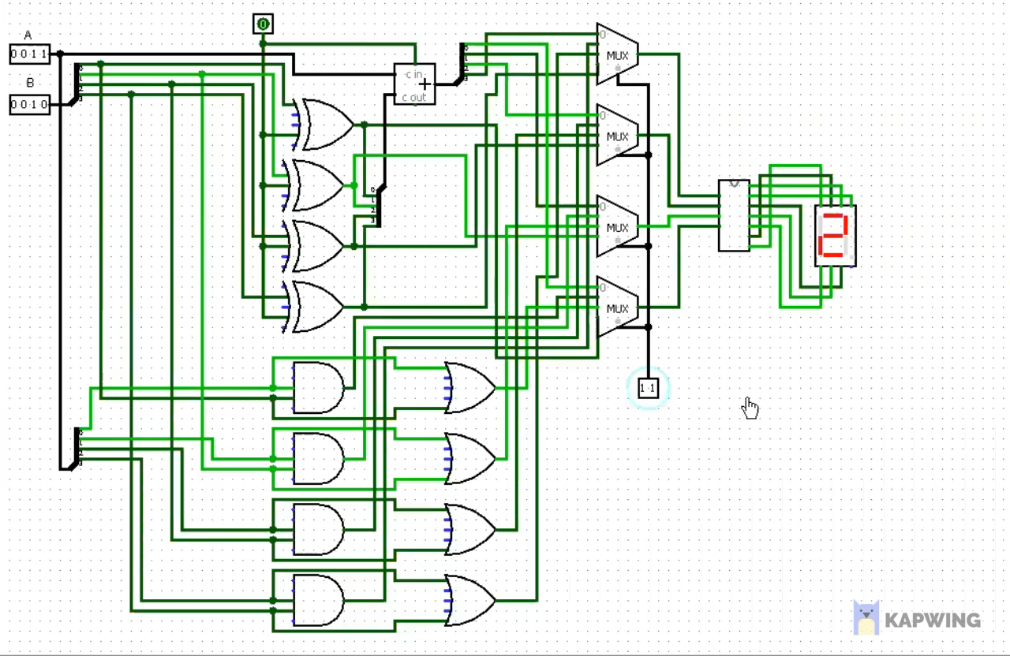
Simulation

Slide 7
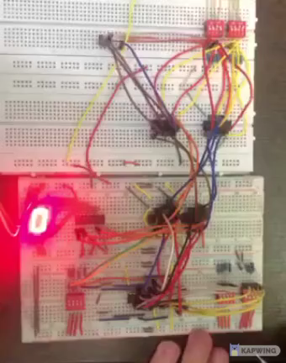
Implemented Circuit

Slide 8
Thanks

